Slide 1
CIND820: Big Data Analytics Project Venture Investments Predictions in Python
Iuliia Sharafutdinova
D1H & 501188055

Slide 2
Table of Contents
Introduction
Exploratory data analysis 1. Country analysis 2. Market analysis 3. Funding analysis Modeling 1. Data preparation 2. Data modeling

Slide 3
Introduction
The dataset about start-up companies is extracted from
CrunchBase dated December 02, 2014 and downloaded
from Data.World website: https://data.world/datanerd/startup-venture-funding.
The dataset is embracing 114,506 number of rows and 24 attributes including
both 1 quantitative and 23 qualitative target attributes.
The main goal is to identify which crucial characteristics found in the sample had the
greatest impact on the success and failure of the startup to receive funding.

Slide 4
Exploratory data analysis
1. Country analysis 2. Market analysis 3. Funding analysis

Slide 5
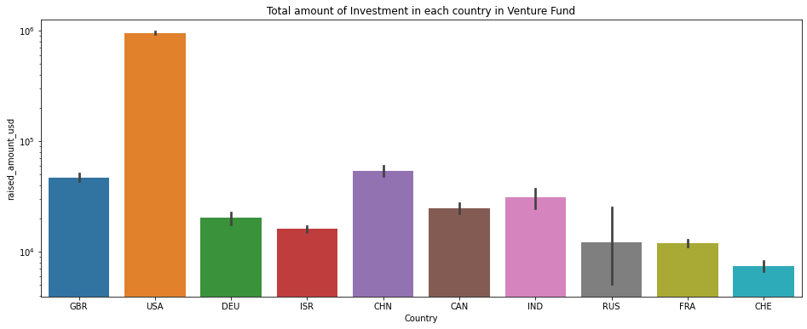
Country Analysis
company_country_code | raised_amount_usd (in million)
United States of America | 947,912.86
China | 54,054.58
The United Kingdom | 47,044.41
India | 30,824.65
Canada | 24,666.40
Germany | 20,154.01
Israel | 16,010.64
Russia | 12,114.16
France | 11,982.18
Switzerland | 7,383.47

Slide 6
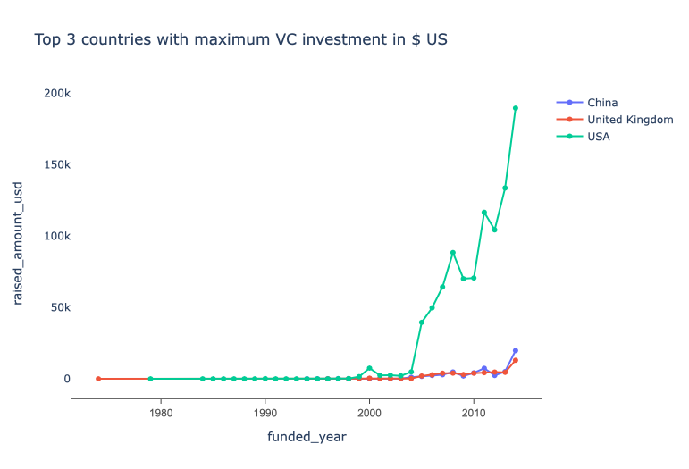
Top 3 countries with maximum investments in $USD

Slide 7
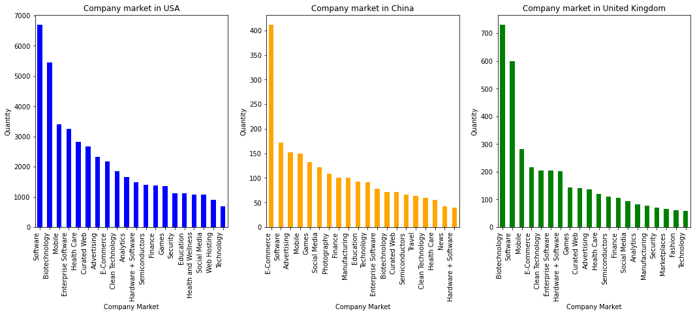
Market analysis

Slide 8
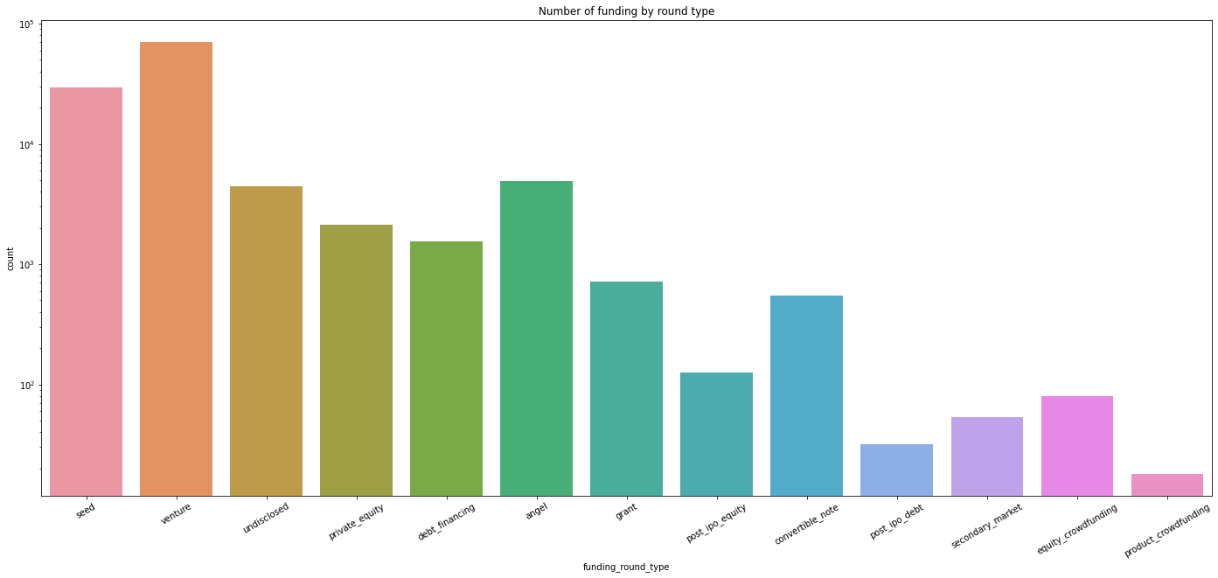
Funding analysis

Slide 9
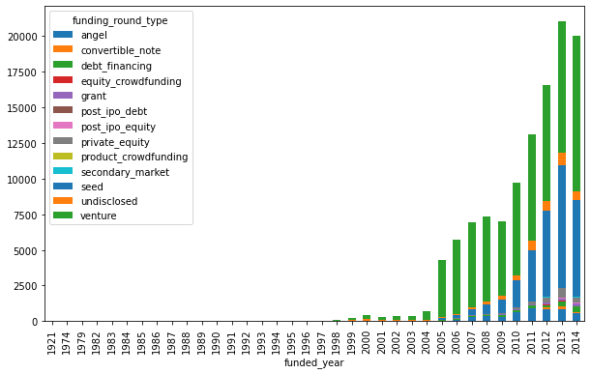
Funding analysis

Slide 10
Modelling 1. Data preparation 2. Data modeling

Slide 11
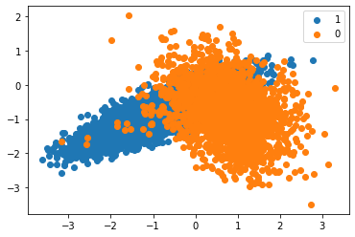
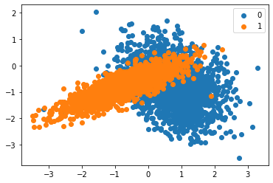

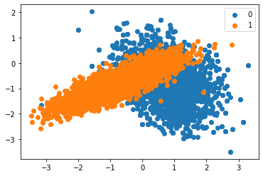
Resumpling with RandomUnderSampler
Imbalanced classification dataset
Data preparation
 | Random UnderSampling | Random OverSampling | Combining Random Oversampling and Undersampling
Model | F1 Score
Decision Tree Classifier | 0.830 | 0.960 | 0.920
Random Forest Classifier | 0.859 | 0.964 | 0.935
Naive Bayes Classifier | 0.854 | 0.863 | 0.857
KNeighbours Classifier | 0.853 | 0.905 | 0.877
1: 7977,
0: 2023
1: 2023,
0: 2023
Resumpling with Combining Random
Oversampling and Undersampling
Resumpling with RandomOverSampler
1: 7977,
0: 7977
1: 3988 ,
0: 4985

Slide 12
Data modeling
ML Model | Parameters | Confusion Matrix | Accuracy | ROC AU
Decision Tree Classifier | max_depth=7 | [[2188 203] [ 367 2029]] | 0.881 | 0.8810
 | max_depth=11 | [[2172 219] [ 245 2151]] | 0.903 | 0.9031
 | max_depth = 15 | [[2281 110] [ 238 2158]] | 0.927 | 0.9273
 | max_depth = None | [[2346 45] [ 209 2187]] | 0.947 | 0.9470
RandomForestClassifier | max_depth=7 | [[2155 236] [ 310 2086]] | 0.886 | 0.8860
 | max_depth=11 | [[2252 139] [ 241 2155]] | 0.921 | 0.9206
 | max_depth=15 | [[2328 63] [ 200 2196]] | 0.945 | 0.9451
 | max_depth = None | [[2350 41] [ 182 2214]] | 0.953 | 0.9534
Naive Bayes Classifier (GaussianNB ( ) ) | -- | [[2100 291] [ 405 1991]] | 0.855 | 0.8546
KNeighborsClassifier | n_neighbors=2 | [[2367 24] [ 377 2019]] | 0.916 | 0.9163
 | n_neighbors=5 | [[2235 156] [ 355 2041]] | 0.893 | 0.8933
 | n_neighbors=10 | [[2162 229] [ 367 2029]] | 0.875 | 0.8755
 | n_neighbors=15 | [[2128 263] [ 311 2085]] | 0.880 | 0.8801

Slide 13
The most impactful criteria for success of a startup to receive venture capital funding
Company market: Biotechnology or Software
Company country code: USA
Investor region code: USA
Stage of funding is venture
The most significant amount of funding received after year 2010

Slide 14
Thank you
Iuliia Sharafutdinova
D1H & 501188055
2022

